Slide 1
IBM Cloud Performance and Scalability
Albee Jhoney
STSM, Cloud Developer Services
IBM
Notes:
IBM Bluemix is the most advanced cloud platform that weaves together services, infrastructure and data to rapidly bring your ideas to production. Offering a full spectrum of compute options ranging from bare metals which gives maximum performance and control to OpenWhisk based serverless application environment that gives maximum speed of delivery, Bluemix enables customers to choose the best of the breed compute that is suited for the solution. The compute offerings also include Container/Container orchestration capabilities which promises high resiliency & portability and CloudFoundry environment for most of the popular runtimes. Architecting and designing optimally performing solutions involves understanding the performance characteristics of the platform and making the right choice of compute, runtime and services. This session gives an insight into the performance and scalability aspects of applications deployed on IBM Bluemix. We will use real customer performance case studies to review the performance characteristics of each compute option, and offer guidance on best practices

Slide 2
Topics
Performance characteristics of IBM Bluemix cloud platform
Microservice architecture and performance
Hybrid Cloud performance
Data services selection for better performance
Tuning tips for Java applications on IBM Bluemix

Slide 3
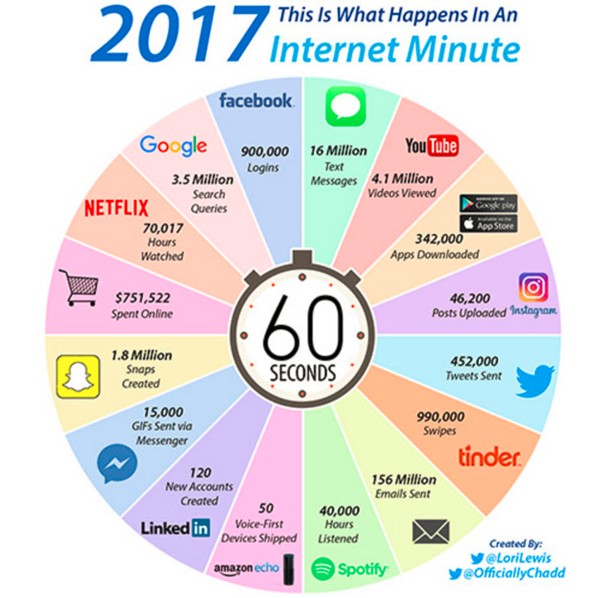
Cloud Performance
What performance means for Cloud Platform Consumer ?
Unlimited Scalability
Guarantee SLAs at peak load
What performance means for Cloud Platform Provider ?
Support more customers per Zone
Resolve Integration & Scalability Bottlenecks
Performance problems manifests as
User experience issues – low throughout, high response times, etc.
Capacity issues – high CPU, high memory consumption, etc.
Root cause for performance problems are
Application architecture issues
Network bandwidth or latency issues
Insufficient computational resources
Application or platform tuning issues
Service integration performance issues
Cloud platform issues like noisy neighbors

Slide 4

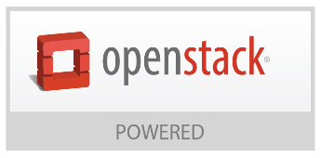
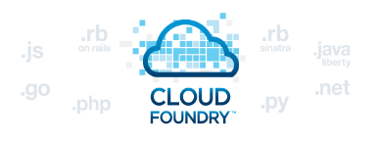

Build your apps, your way
Use a combination of the most prominent open-source compute technologies to power your apps. Then, let Bluemix handle the rest.
OpenWhisk
Instant Runtimes
IBM Containers
Virtual Machines
Bare Metal
Event-driven apps, deployed in a
serverless environment
App-centric runtime
environments
based on Cloud Foundry
Portable and consistent
delivery of your app
without having to
manage an OS
Get the most
flexibility and control over your environment
For the ultimate
performance and
scale
Ease of getting started
Full stack Control

Slide 5
Case study - Online Banking Application
Performance and scalability – Bluemix application on Cloud Foundry

Slide 6
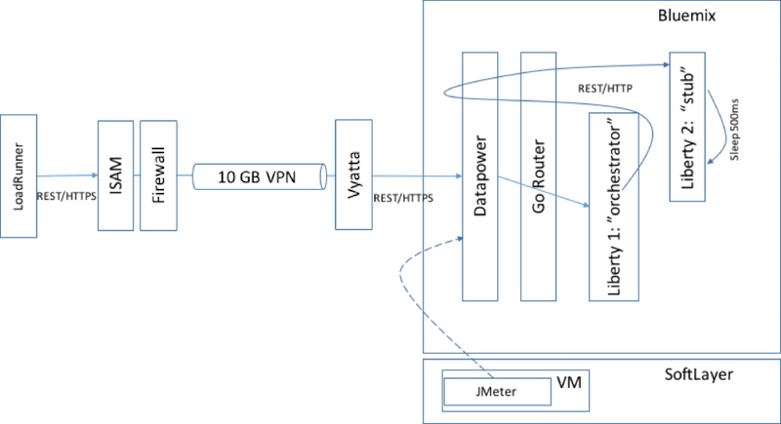
Workload: Customer-facing retail online banking
Transaction scenario: Open individual account summary page
Loosely follows the microservices design pattern
Orchestrator microservice – provides data for the ‘account summary page’
Stub microservice – simulates the back-end data requests, returns pre-loaded back-end data after a pre-determined delay
Workload security
On-premises enterprise security reverse proxy (IBM Security Access Manager),
VPN connection to Bluemix Dedicated instance, and firewalls.
Traffic is encrypted with SSL, which is terminated at DataPower® inside Bluemix and subsequently encrypted via IPSec inside Bluemix.
The Orchestrator microservice is configured with Trust Association Interceptor (TAI) login module for Liberty Application Server, which allows it to authenticate ISAM credentials and decode user identity propagated from ISAM.

Slide 7
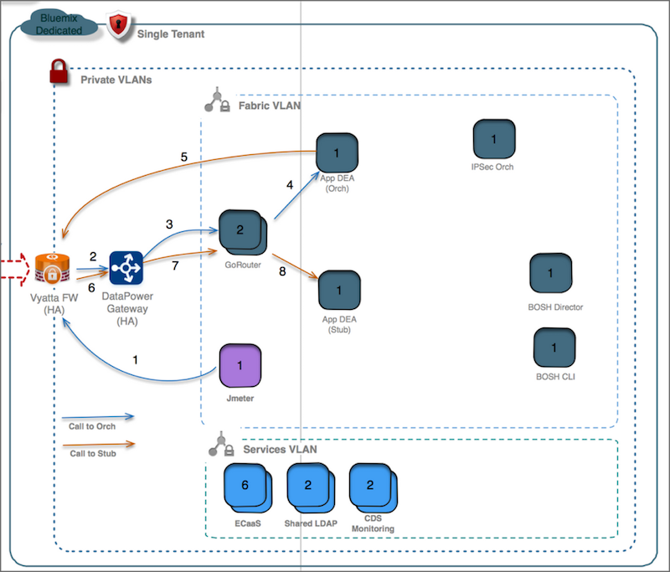
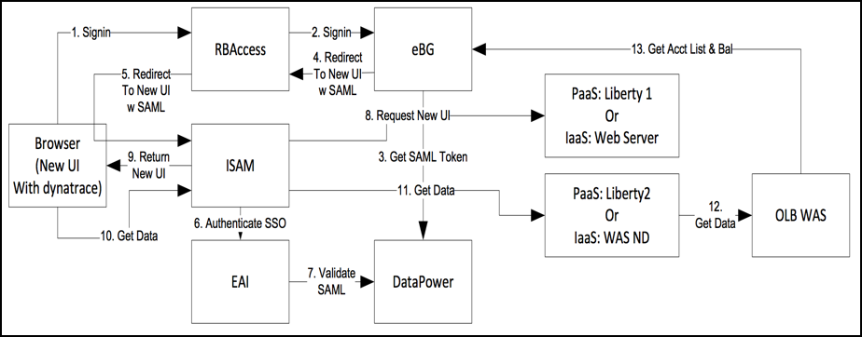
Performance objective
Can IBM Bluemix support 500-600 tps peak traffic with sub second response times in production (for the simulated ‘Retail Online Banking’ application – with UI, Security and Services)?
Traffic is encrypted across the board and users are authenticated (using TAI for Liberty)
Platform stability & consistency, while running the application at peak load for 6-8 Hours
Fig. Online Banking Transaction Flow
Fig. Network view of the platform: Transactions flow

Slide 8
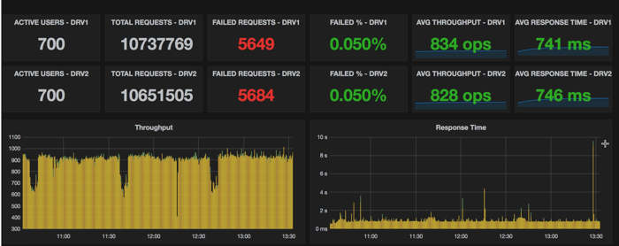
Performance results
Can Bluemix support 500-600 OLB tps @sub-second response time with stability over a period of time?
Yes. more than 21 million HTTP requests were served by 6 application instances
Throughput: 831 transactions/sec (1662 REST operations/sec) [> 600 tps]
Response time: 741 milliseconds [< 1 sec]
Endurance test: sustained peak load for about 6-24 hours continuously
6 instances of Orchestrator and Stub services
Orchestrator: ~98% avg CPU usage
Stub: ~45% avg CPU usage
capacity available for other apps

Slide 9
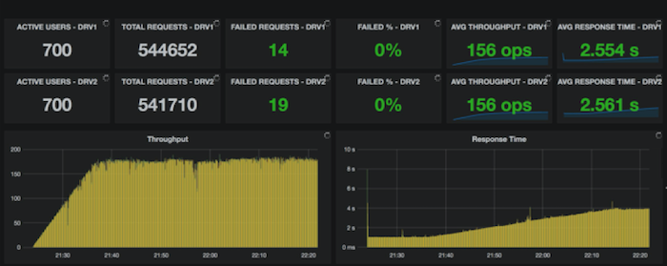
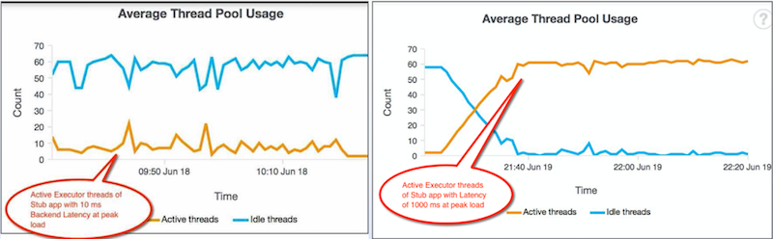
Guidelines - Impact of back-end service latency
Stub services – simulated the backend latency
100-200 milliseconds (eg. mainframe application)
Observed poor performance (high backend latency)
Cause: Liberty thread management algorithm
adjusts the thread pool size dynamically based on the workload
works well for normal latency scenarios
should not be used for high latency scenarios
Guidance
Always measure the back-end service latency
Observe the executor thread pool behavior at peak load, for the Java application to identify latency issue
For high latency backend
bypass the default Liberty threading algorithm
explicitly set the executor thread pools in server.xml file of the application

Slide 10
Online banking application case study - summary
Other guidances
Sticky sessions on auto-scaling
Impacts horizontal scalability
Disable sticky session (in web.xml) to ensure that the load is uniformly distributed amongst the dynamically provisioned application instances
Java heap tuning
Java heap sizing is ensures optimum performance Java application, and can avoid Out of Memory (OOM) situations,
For Java applications, the correct heap size can be found through some iterative testing at peak load or by inspecting the verbose garbage collection data.
Summary
Bluemix cloud platform can support the required peak performance levels (more than 72 million API calls per day with sub-second response time) with required agility and elasticity.
Assess back-end service latency and auto-scale session affinity to avoid performance issues.
IBM Bluemix cloud platform is designed for mission critical enterprise banking applications.

Slide 11
IBM Container Services
Performance & Scalability

Slide 12
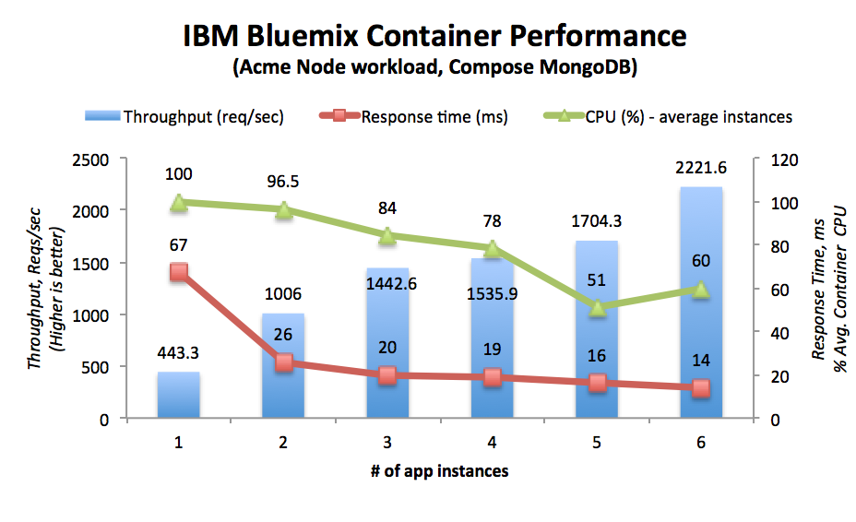
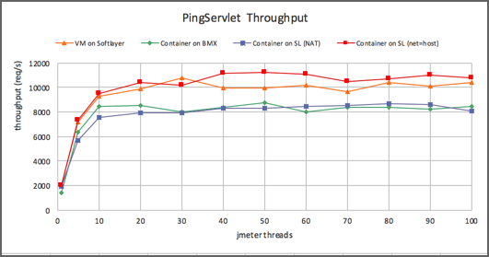
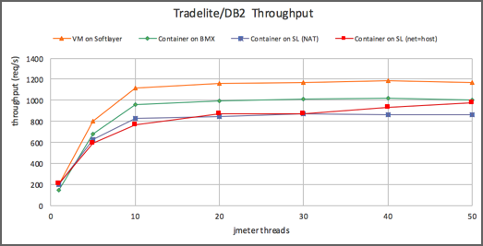
Application Performance on IBM Container Services (gen-1)
Node Application
Network Intensive Java Applications
Data Intensive Java Applications
Illustrates the horizontal scalability with multiple container instances supporting the workload with specified throughput
Network intensive applications running on Bluemix Containers need about 20% more compute power compared to containers running on SoftLayer
Setting a network option of net=host gives better performance for network intensive workloads while running on Docker Containers on SL, mainly eliminating NAT overhead
For data intensive applications, need about 20% higher compute power running on IBM Containers compared to running on SoftLayer VMs
The network option of net=host does not impact much on data intensive applications running on Containers on SL
For data intensive applications, Containers on Bluemix perform better

Slide 13
Application Performance on IBM Container Services (gen-2)
k8s
No additional overhead for applications on Kubernetes (k8s) cluster, when compared to running directly on a Docker container on SL VM with E2E Workloads
Both IBM Container Services (k8s) and direct Docker Container on SL VM showcase similar scalability characteristics
Network Latency that will affect scalability of apps in the cluster
from Client to app on the Kubernetes cluster
from app in the Kubernetes cluster to Data Service

Slide 14
Application Performance on IBM Container Services (gen-2)
Impact of attached storage on performance
Compared to default storage, attached storage helps towards stable performance of applications on IBM Container Services (on Kubernetes)

Slide 15
Microservice Performance

Slide 16

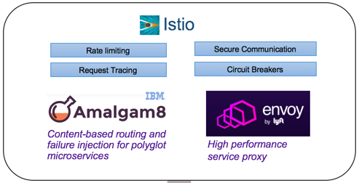
Microservices design considerations
12-factor application design principles
https://12factor.net/
Z-axis scalability
Scale Cube
Selection of critical Fabric Services
Service Proxy
Service Discovery
Resiliency

Slide 17
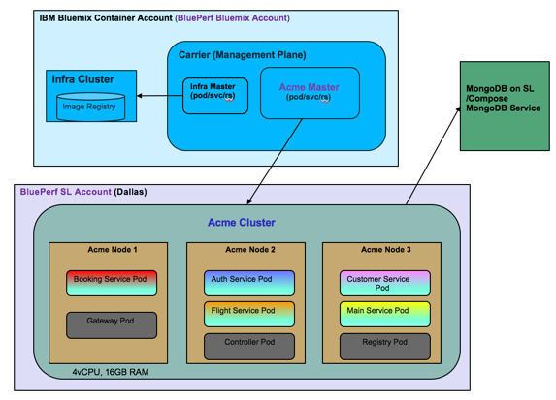
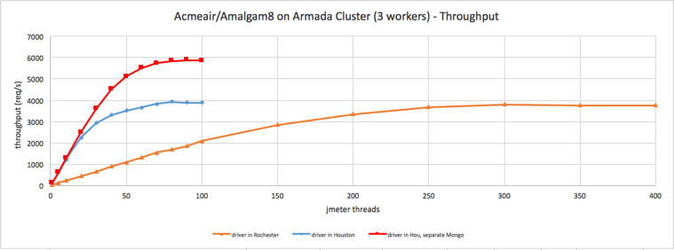
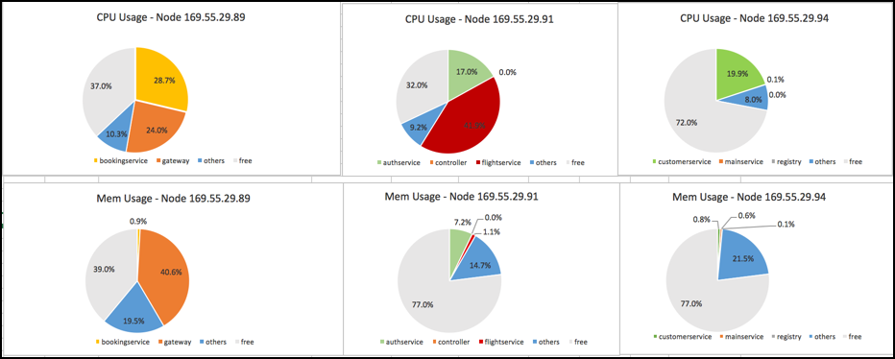
IBM Container Services performance (Acmeair Microservices App)
Acme air microservices running on Kubernetes clusters on IBM Bluemix Container Service
Correct distribution of services across Pods is crucial for microservices scalability

Slide 18
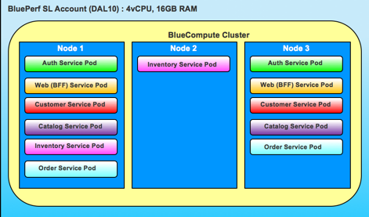
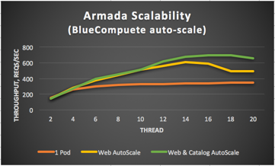
IBM Container Services performance (Acmeair Microservices App)
Microservice scalability (BlueCompute auto-scale)
BlueCompute microservices application scaling on Kubernetes Cluster using auto-scale policy
Z-axis scaling is possible through giving enough resources to Web and Catalog services more instances
Guidance
Leverage z-axis scaling in a scale-cube
Allocate the right compute power to the microservices to maximize performance
Observation: JAX-RS Client invocations have higher overhead compared to simple HTTP service invocations

Slide 19
Hybrid Cloud Performance
Performance & scalability

Slide 20
Considerations for Hybrid Cloud scalability
Network Latency between Cloud applications and On Premise resources
Selection of right Bluemix service for accessing On Premise resources
VPN Overhead Considerations
Secure Gateway Tuning Considerations
VPN Service Tuning Considerations

Slide 21
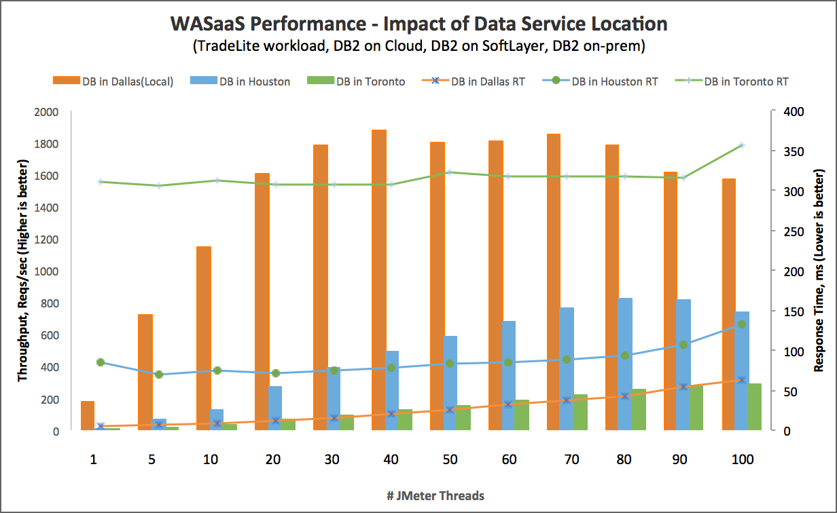
Impact of network latency
Performance of apps deployed in WASaaS connecting to remote db depends heavily on network latency
Performance of app accessing data from remote location (remote-1) is much slower than accessing the data from another remote location (remote-2) that is farther (network-distance)
For the remote DB access scenario, the best way to reduce the network latency is to use a direct dedicated line between the data centers which can reduce the overhead to meet the SLAs
DB Local
DB Remote-1
DB Remote-2
RT for DB Local
RT for DB Remote-1
RT for DB Remote-2

Slide 22
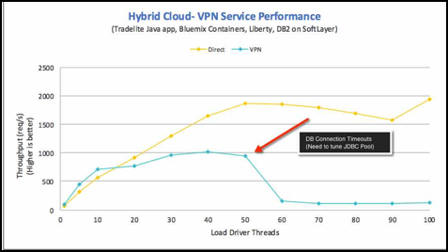
VPN Service performance
Performance and scalability of Bluemix VPN Service used for Hybrid Cloud on Bluemix Containers with data centric workloads
Cloud scale Java application accessing remote DB Service through VPN Service performs similar to a Direct access scenario as the VPN service overhead is very small
While working on Data centric workloads, for a better scalability with VPN service, tune the JDBC pools correctly

Slide 23
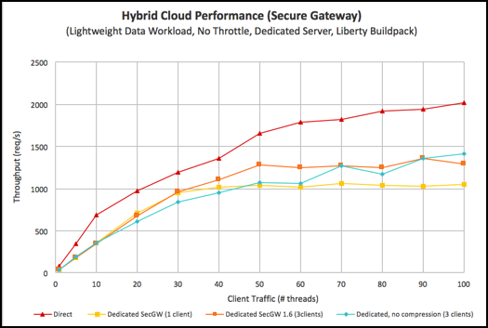
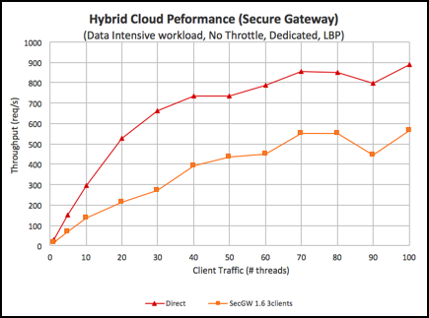
Secure Gateway performance and scalability
Secure Gateway is used to access on premise services
Public Secure Gateway Service has a throttle mechanism that controls the rate of traffic
Parallelizing the traffic between SW Server and Client will Improve Performance
The data traffic determines the overhead of Secure Gateway
Secure Gateway Service Performance on Bluemix (Lighter Data Traffic)
Secure Gateway Service Performance on Bluemix (Data Intensive)

Slide 24


Please give us your valuable feedback
http://ibm.biz/devconnect17

Slide 25


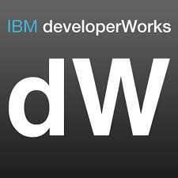

Stay Connected and continue coding !
Code & instructions available here https://github.com/IBMDevConnect17
Join our Meetup groups
Mumbai : https://www.meetup.com/Cloud-Mumbai-Meetup/
Hyderabad: https://www.meetup.com/Hyderabad-Cognitive-with-Cloud
Bangalore : https://www.meetup.com/IBMDevConnect-Bangalore
Join developerWorks India Community
https://developer.ibm.com/in/
Check out the cool developer journeys
https://developer.ibm.com/code/
Join our Slack team and stay in touch with the experts
https://ibmdevconnect.slack.com
Send in your request to - http://ibm.biz/slackrequest

Slide 26
Notices and disclaimers
Copyright © 2017 by International Business Machines Corporation (IBM). No part of this document may be reproduced or transmitted in any form without written permission from IBM.
U.S. Government Users Restricted Rights — use, duplication or disclosure restricted by GSA ADP Schedule Contract with IBM.
Information in these presentations (including information relating to products that have not yet been announced by IBM) has been reviewed for accuracy as of the date of initial publication and could include unintentional technical or typographical errors. IBM shall have no responsibility to update this information. This document is distributed “as is” without any warranty, either express or implied. In no event shall IBM be liable for any damage arising from the use of this information, including but not limited to, loss of data, business interruption, loss of profit or loss of opportunity. IBM products and services are warranted according to the terms and conditions of the agreements under which they are provided.
IBM products are manufactured from new parts or new and used parts. In some cases, a product may not be new and may have been previously installed. Regardless, our warranty terms apply.”
Any statements regarding IBM's future direction, intent or product plans are subject to change or withdrawal without notice.
Performance data contained herein was generally obtained in a controlled, isolated environments. Customer examples are presented as illustrations of how those customers have used IBM products and the results they may have achieved. Actual performance, cost, savings or other results in other operating environments may vary.
References in this document to IBM products, programs, or services does not imply that IBM intends to make such products, programs or services available in all countries in which IBM operates or does business.
Workshops, sessions and associated materials may have been prepared by independent session speakers, and do not necessarily reflect the views of IBM. All materials and discussions are provided for informational purposes only, and are neither intended to, nor shall constitute legal or other guidance or advice to any individual participant or their specific situation.
It is the customer’s responsibility to insure its own compliance with legal requirements and to obtain advice of competent legal counsel as to the identification and interpretation of any relevant laws and regulatory requirements that may affect the customer’s business and any actions the customer may need to take to comply with such laws. IBM does not provide legal advice or represent or warrant that its services or products will ensure that the customer is in compliance with any law.

Slide 27
Notices and disclaimers continued
Information concerning non-IBM products was obtained from the suppliers of those products, their published announcements or other publicly available sources. IBM has not tested those products in connection with this publication and cannot confirm the accuracy of performance, compatibility or any other claims related to non-IBM products. Questions on the capabilities of non-IBM products should be addressed to the suppliers of those products. IBM does not warrant the quality of any third-party products, or the ability of any such third-party products to interoperate with IBM’s products. IBM expressly disclaims all warranties, expressed or implied, including but not limited to, the implied warranties of merchantability and fitness for a particular, purpose.
The provision of the information contained herein is not intended to, and does not, grant any right or license under any IBM patents, copyrights, trademarks or other intellectual property right.
IBM, the IBM logo, ibm.com, Aspera®, Bluemix, Blueworks Live, CICS, Clearcase, Cognos®, DOORS®, Emptoris®, Enterprise Document Management System™, FASP®, FileNet®, Global Business Services®, Global Technology Services®, IBM ExperienceOne™, IBM SmartCloud®, IBM Social Business®, Information on Demand, ILOG, Maximo®, MQIntegrator®, MQSeries®, Netcool®, OMEGAMON, OpenPower, PureAnalytics™, PureApplication®, pureCluster™, PureCoverage®, PureData®, PureExperience®, PureFlex®, pureQuery®, pureScale®, PureSystems®, QRadar®, Rational®, Rhapsody®, Smarter Commerce®, SoDA, SPSS, Sterling Commerce®, StoredIQ, Tealeaf®, Tivoli® Trusteer®, Unica®, urban{code}®, Watson, WebSphere®, Worklight®, X-Force® and System z® Z/OS, are trademarks of International Business Machines Corporation, registered in many jurisdictions worldwide. Other product and service names might be trademarks of IBM or other companies. A current list of IBM trademarks is available on the Web at "Copyright and trademark information" at: www.ibm.com/legal/copytrade.shtml.

Slide 28
IBM Cloud Performance and Scalability
Thank You
Albee Jhoney
STSM, Cloud Developer Services
IBM
Notes:
IBM Bluemix is the most advanced cloud platform that weaves together services, infrastructure and data to rapidly bring your ideas to production. Offering a full spectrum of compute options ranging from bare metals which gives maximum performance and control to OpenWhisk based serverless application environment that gives maximum speed of delivery, Bluemix enables customers to choose the best of the breed compute that is suited for the solution. The compute offerings also include Container/Container orchestration capabilities which promises high resiliency & portability and CloudFoundry environment for most of the popular runtimes. Architecting and designing optimally performing solutions involves understanding the performance characteristics of the platform and making the right choice of compute, runtime and services. This session gives an insight into the performance and scalability aspects of applications deployed on IBM Bluemix. We will use real customer performance case studies to review the performance characteristics of each compute option, and offer guidance on best practices

Slide 29
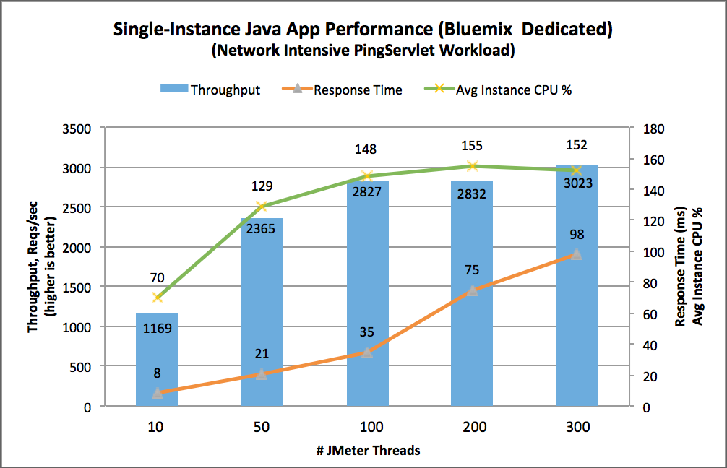
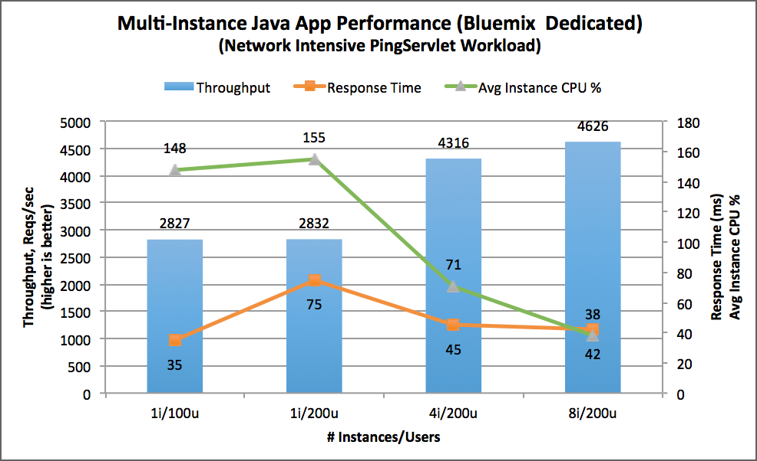
Scalability of Network Intensive Application on IBM Bluemix (Single vs. Multiple instance)
Very lightweight network intensive java workloads running in Bluemix Dedicated with Liberty Buildpack
Each instance can support 2827 reqs/sec at response time of 35 ms
‘Knee of the curve’ reached by 100 JMeter threads, beyond which - its recommended to scale horizontally
After saturating at 100 concurrent JMeter threads, doubling the load only increased the response time without much change in throughput
By spreading the load to 4-8 instances, the response time dropped with increased throughput

Slide 30
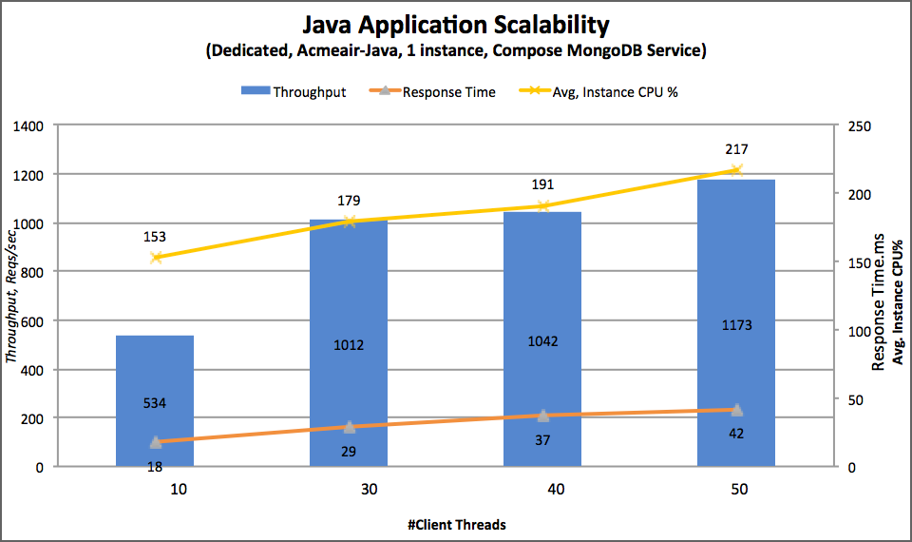
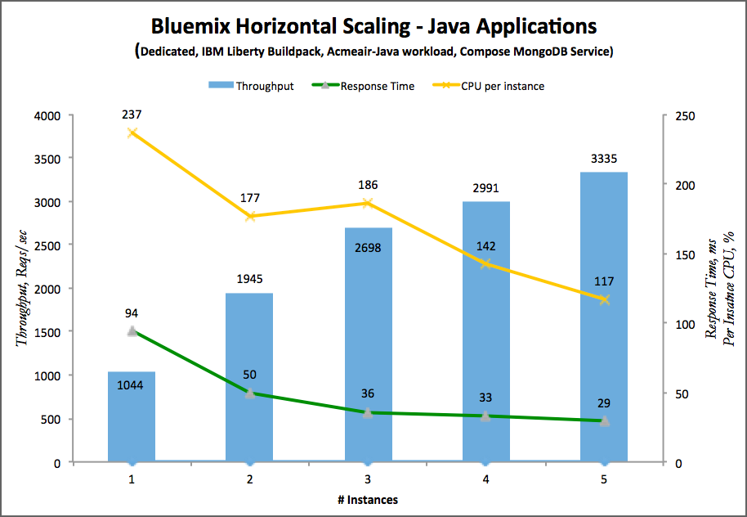
Scalability of Java Application on IBM Bluemix (Single vs. Multiple instance)
Bluemix Dedicated is a high performing Cloud Platform for Java workloads using Liberty Buildpack
A single instance of an application can support significant number of transactions at reasonable response time
Peak load can be supported with multiple application instances scaling horizontally

Slide 31
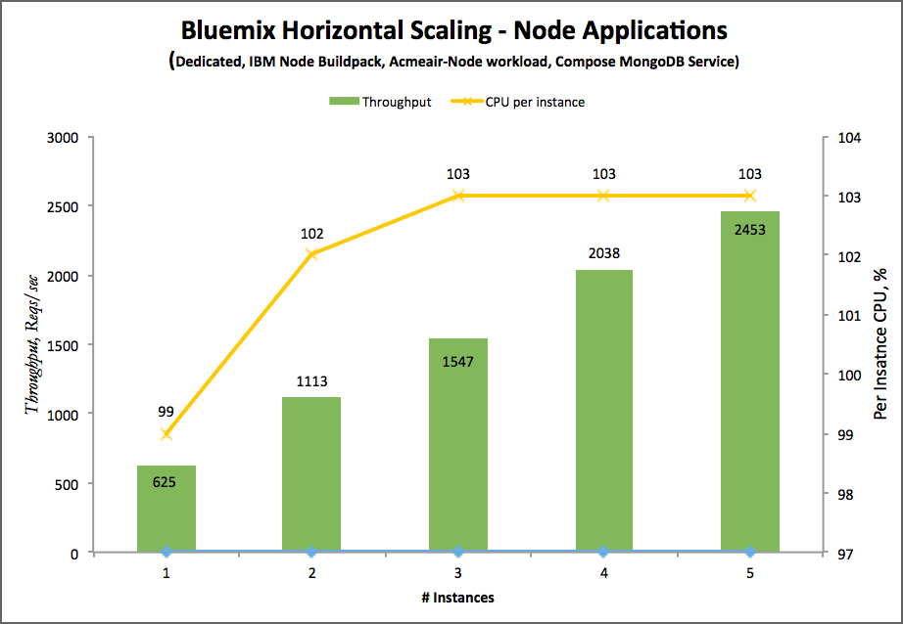
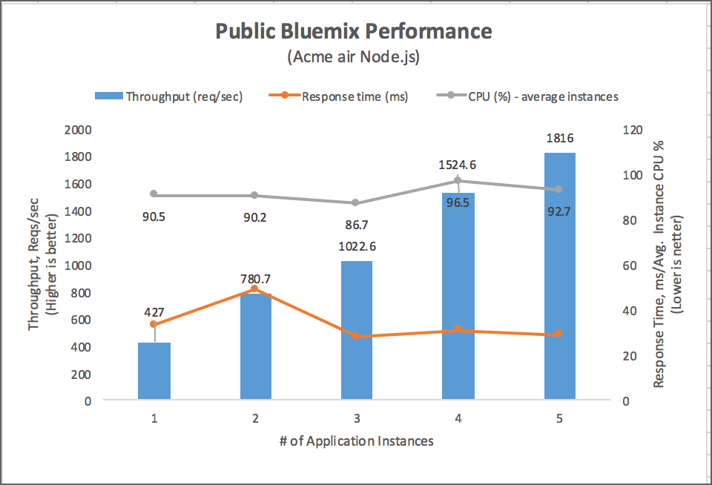
Scalability of Node Application on IBM Bluemix (Single vs. Multiple instance)
Bluemix Dedicated & Public is a high scalable Cloud Platform for Node workloads using IBM Node Runtime
Peak load can be supported with multiple application instances scaling horizontally with low response times
Compared to Dedicated Bluemix performance, Public Bluemix performance is slightly lower and will be impacted by other tenants using the platform

Slide 32
Cloud Data services
Selection for better performance

Slide 33





Database Selection shift from Bare Metal to Cloud
Bare Metal
Cloud
?
MySQL
DB2
Oracle
Now the database runs on Cloud. Which DB to choose?

Slide 34
Database characteristics consideration
Atomic vs. Non-Atomic
A series of database operations either all occur, or nothing occurs In case of partial insert/update/delete, its operation will be rolled back
Storage (Memory vs. Disk)
Data can be saved in memory or disk. Some databases first save data in memory, then periodically write to disk. Depending on the design, some databases are durable and others are write acknowledge, or non-durable at all
Scale/Sharding
Scalability is achieved by splitting the data sets into multiple shard servers. Depending on the database, grouping of each data set in each sharding is different
High Availability & Data Consistency
Primary & secondary replica sets vs. Quorum
High Data consistency is achieved by Primary & Secondary replica sets, however, Quorum also has mechanism for the data consistency at some level
Quorum is highly available in multiple regions. Primary & secondary replica sets can achieve high availability using multiple copies of replica sets as long as the router is accessible and a complete replica set is accessible from this router

Slide 35
Types of Database
There are 14 known different types/models of Database (http://db-engines.com/en/ranking). Here are some known Database Systems
Relational DBMS
Use Structured Query Language to query data spread around multiple tables using join operation
Use BCNF Database Design to save structured data (although to gain performance, it is better to de-normalize it)
All fields must be populated with data (if there is no data, store null)
Difficult to change database schema (design)
Difficult to horizontally scale if the data is normalized to multiple tables & needs to be joined to provide results.
Document Stores
Able to store unstructured data
Use Domain Driven Design (DDD) to save unstructured data
There are no set fields. Stores only data (if there is no data, it won’t store)
No database schema, any JSON format can be saved
Data is saved per JSON document. All related data are easily queried
Key-value Stores
Value (dictionary/hash) is retrieved using a key
It uses far less memory to store data
Treat data as a single opaque collection which provides flexibility
Wide Column Stores
It is a type of key-value model
Query-first schema design. All possible queries need to be identified first, then group together the data that will be read together for better performance
It uses tables, rows and columns with compound primary key. One or more primary key values act as a “column name”, and using one or more primary keys to search & manipulate values
Database schema is fixed at the beginning. Changing the database schema might cause massive code change.
Graph DBMS
Use Nodes, edges and properties to represent data
It allows simple rapid data retrieval of complex hierarchical structures

Slide 36
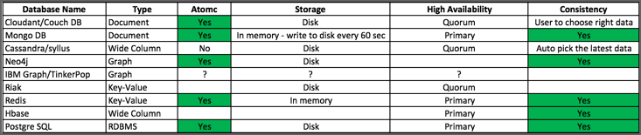
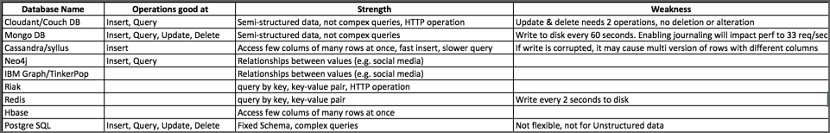
Data Service selection criteria

Slide 37
Data Service performance
Select the correct Data Service to get greater application performance and scalability
Review the Data service best practices and apply them for production for better performance

Slide 38
Impact of durability on Data Service performance
Database durability QoS impacts the performance
Understand the default durability of the data service and adjust as per the requirements of the application

Slide 39
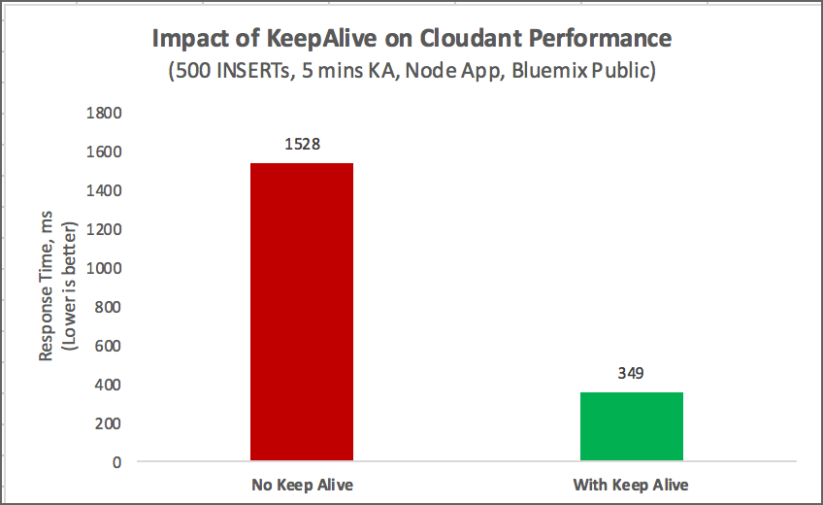
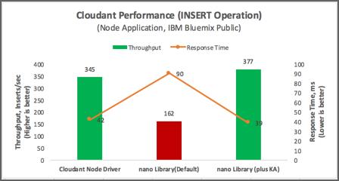
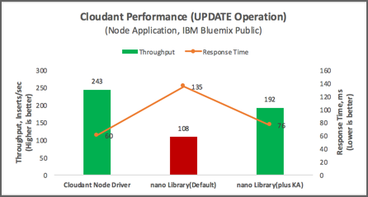
Impact of Keep Alive on Cloudant Performance
Cloudant client libraries
Most of the applications use Nano / PouchDB libraries, Update these libraries with Keep-Alive support to get the best performance
Both UPDATE and INSERT operations incur significant performance degradation without Keep Alive
Cloudant server has Keep-Alive timeout value of 2.5 mins
Since Cloudant is based on HTTP model, Keep-Alive setting is crucial for performance

Slide 40
Java application on Bluemix
Performance tuning tips

Slide 41
Performance tuning tips for Java Applications on Bluemix
For better performance of most Java applications, reduce the backend service latency
For larger backend service latency Java applications,
avoid using default Liberty Threading model and use manual Executor thread configuration instead
increase the Executor thread pool size to a much higher value based on the expected peak load
While setting the manual thread pool size, set the core threads to a value that is required for peak load not depending much on expansion process to Max Threads
Java applications need higher Heap Size compared to Node and Swift applications
Tune and configure the heap/JVM appropriately for the peak load, in order to avoid Out-Of-Memory situations,
Increase the concurrency for better availability and performance of Online Banking type applications
Disable sticky sessions while using auto-scale service to avoid uneven load balancing

